Slide 1
Mongo DB
Akbar Gadhiya
Programmer Analyst
JUNE, 2014

Slide 2
About presenter
Akbar Gadhiya has 10 years of experience.
He started his career in 2004 with HCL Technologies.
Joined Ishi systems in 2010 as a programmer analyst.
Got exposure to work on noSQL technologies MongoDB, Hbase.
Currently engaged in a web based product.

Slide 3
Agenda
Introduction
Features
RDBMS & NoSQL (MongDB)
CRUD
Workshop
Break
Aggregation
Workshop
Replication & Shard
Questions

Slide 4
The family of NoSQL DBs
Key-values Stores
Hash table where there is a unique key and a pointer to a particular item of data.
Focus on scaling to huge amounts of data
E.g. Riak, Voldemort, Dynamo etc.
Column Family Stores
To store and process very large amounts of data distributed over many machines
E.g. Cassandra, HBase

Slide 5
The family of NoSQL DBs – Contd.
Document Databases
The next level of Key/value, allowing nested values associated with each key.
Appropriate for Web apps.
E.g. CouchDB, MongoDb
Graph Databases
Bases on property-graph model
Appropriate for Social networking, Recommendations
E.g. Neo4J, Infinite Graph

Slide 6
Introduction
Document-Oriented storage - BSON
Full Index Support
Schema free
Capped collections (Fast R/W, Useful in logging)
Replication & High Availability
Auto-Sharding
Querying
Fast In-Place Updates
Map/Reduce

Slide 7
Why to use MongoDB?
MongoDB stores documents (or) objects.
Everyone works with objects (Python/Ruby/Java/etc.)
And we need Databases to persist our objects. Then why not store objects directly?
Embedded documents and arrays reduce need for joins. No Joins and No-multi document transactions.

Slide 8
When to use MongoDB?
High write load
High availability in an unreliable environment (cloud and real life)
You need to grow big (and shard your data)
Schema is not stable

Slide 9
RDBMS - MongoDB
MongoDB is not a replacement of RDBMS

Slide 10
RDBMS - MongoDB
RDBMS | MongoDB
Database | Database
Table | Collection
Row | Document(JSON, BSON)
Column | Field
Index | Index
Join | Embedded Document
Foreign Key | Reference
Partition | Shard
Stored Procedure | Stored Java script

Slide 11
RDBMS - MongoDB
RDBMS | MongoDB
Database | Database
Table, View | Collection
Row | Document(JSON, BSON)
Column | Field
Index | Index
Join | Embedded Document
Foreign Key | Reference
Partition | Shard
Stored Procedure | Stored Java script
> db.user.findOne({age:39})
{
"_id" : ObjectId("5114e0bd42…"),
"first" : "John",
"last" : "Doe",
"age" : 39,
"interests" : [
"Reading",
"Mountain Biking ]
"favorites": {
"color": "Blue",
"sport": "Soccer"}
}

Slide 12
Object Id composition
12 Bytes
ObjectId("51597ca8e28587b86528edfd”)
Timestamp
Host
PID
Counter

Slide 13
CRUD
Create
db.collection.insert( <document> )
db.collection.save( <document> )
db.collection.update( <query>, <update>, { upsert: true } )
Read
db.collection.find( <query>, <projection> )
db.collection.findOne( <query>, <projection> )
Update
db.collection.update( <query>, <update>, <options> )
db.collection.update( <query>, <update>, {upsert, multi} )
Delete
db.collection.remove( <query>, <justOne> )

Slide 14
CRUD - Examples
db.user.insert(
{
first: "John",
last : "Doe",
age: 39
})
db.user.find(
{
age: 39
})
db.user.update(
{age: 39},
{
$set: {age: 40, salary: 50000}
})
db.user.insert(
{
first: "John",
last : "Doe",
age: 39
})

Slide 15
Lets start server
Download and unzip https://fastdl.mongodb.org/win32/mongodb-win32-x86_64-2008plus-2.6.3.zip
Add bin directory to PATH (Optional)
Create a data directory
mkdir C:\data
mkdir C:\data\db
Open command line and go to bin directory
Run mongod.exe [--dbpath C:\data\db]

Slide 16
Workshop
Inserts using java program and observe stats
Create
Read
Update
Upsert
Delete
Update all documents with new field country India for city Ahmedabad and Mumbai.

Slide 17
Aggregation
Pipeline
Series of pipeline – Members of a collection are passed through a pipeline to produce a result
Takes two argument
Aggregate – Name of a collection
Pipeline – Array of pipeline operators
$match, $sort, $project, $unwind, $group etc.
Tips – Use $match in a pipeline as early as possible

Slide 18
Aggregation – By examples
Find max by subject
db.runCommand({ "aggregate" : "student" ,
"pipeline" : [
{ "$unwind" : "$subjects"} ,
{ "$match" : { "subjects.name" : "Maths"}} ,
{ "$group" : { "_id" : "$subjects.name" ,
"max" : { "$max" : "$subjects.marks"}}}]});

Slide 19
Aggregation – By examples
Number of students who opted English as an optional subject
Count students by city
Find top 10 students who scored maximum marks in mathematics subject

Slide 20
Aggregation - Workshop
find top 10 students by percentage in required subjects only

Slide 21
Aggregation - Workshop
find top 10 students by percentage in required subjects only
{ "aggregate" : "student" , "pipeline" : [
{ "$unwind" : "$subjects"} ,
{ "$match" : { "subjects.name" :
{ "$in" : [ "Maths" , "Chemistry" , "Physics" , "Biology"]}}} ,
{ "$project" : { "firstName" : 1 , "lastName" : 1 , "subjects.marks" :1}} ,
{ "$group" : { "_id" : "$firstName" ,
"total" : { "$avg" : "$subjects.marks"}}} ,
{ "$sort" : { "total" : -1}} , { "$limit" : 10}]}

Slide 22
Map Reduce
A data processing paradigm for large volumes of data into useful aggregated results
Output to a collection
Runs inside MongoDB on local data
Adds load to your DB only
In Javascript

Slide 23
Map Reduce – Purchase data
Find total amount of purchases made from Mumbai and Delhi
db.purchase.mapReduce(function(){
emit(this.city, this.amount);
},
function(key, values) {
return Array.sum(values)
},
{
query: {city: {$in: ["Mumbai", "Delhi"]}},
out: "total"
});

Slide 24
Map Reduce – Purchase data
Find total amount of purchases made from Mumbai and Delhi
{ "city" : "Mumbai", "name" : "Charles", "amount" : 4534 }
{ "city" : "Mumbai", "name" : "Charles", "amount" : 1498 }
{ "city" : "Delhi", "name" : "David", "amount" : 4522 }
{ "city" : "Ahmedabad", "name" : "David", "amount" : 4974 }
{ "city" : "Mumbai", "name" : "Charles", "amount" : 4534 }
{ "city" : "Mumbai", "name" : "Charles", "amount" : 1498 }
{ "city" : "Delhi", "name" : "David", "amount" : 4522 }
{ “Mumbai" : [4534, 1498] }
{ “Mumbai" : 6032 }
{ “Delhi" : 4522}
Query
map
reduce
{ “Delhi" : [4522] }

Slide 25
Map Reduce – By examples
Find total purchases by name
Find total number of purchases and total purchases by city
Find total purchases by name and city

Slide 26
Replication
Automatic failover
Highly available – No single point of failure
Scaling horizontally
Two or more nodes (usually three)
Write to master, read from any
Client libraries are replica set aware
Client can block until data is replicated on all servers (for important data)

Slide 27
Replica set
A cluster of N servers
Any (one) node can be primary
Election of primary
Heartbeat every 2 seconds
All writes to primary
Reads can be to primary (default) or a secondary

Slide 28
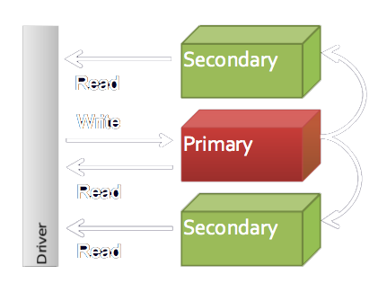
Replica set – Contd...
Only one server is active for writes (the primary) at a given time – this is to allow strong consistent (atomic) operations. One can optionally send read operations to the secondary when eventual consistency semantics are acceptable.

Slide 29
Replica set – Demo
Three nodes – One primary and two secondaries
Start mongod instances
rs.initiate()
rs.conf()
Add replicaset
rs.add("ishiahm-lt125:27018")
rs.add("ishiahm-lt125:27019")
rs.status();
Check in each node

Slide 30
Sharding
Provides horizontal scaling vs vertical scaling
Stores data across multiple machine
Data partitioning
High throughput
Shard key
Cloud-based providers provisions smaller instances. As a result there is a practical maximum capability for vertical scaling.

Slide 31
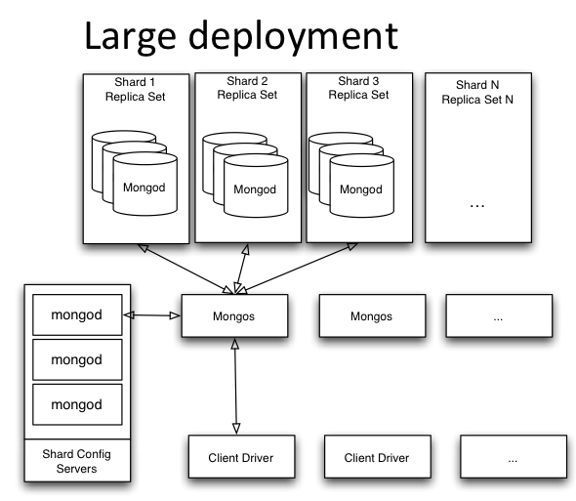
Sharding Topology

Slide 32
Sharding Components
Config server
Persist shard cluster's metadata: global cluster configuration, locations of each database, collection and the ranges of data therein.
Routing server
Provides an interface to the cluster as a whole. It directs all reads and writes to the appropriate shard.
Resides in same machine as the app server to minimize network hops.
Shards
A shard is a MongoDB instance that holds a subset of a collection’s data.
Each shard is either a single mongod instance or a replica set. In production, all shards are replica sets.
Shard Key
Key to distribute documents. Must exist in each document.
Notes:
Routing server
Typically the mongos process resides in the same machine as the application server in order to minimize the necessary network hops.

Slide 33
Sharding
Start 3 config servers
Create replica set for India and USA. Each raplica sets having 3 data nodes.
Start routing process
Create replica set for India
mongo.exe --port 27011
rs.initiate()
rs.add("ishiahm-lt125:27012")
rs.add("ishiahm-lt125:27013")

Slide 34
Sharding
Create replica set for USA
mongo.exe --port 27014
rs.initiate()
rs.add("ishiahm-lt125:27015")
rs.add("ishiahm-lt125:27016")
Add shards
Connect to mongos - mongo.exe --port 25017
sh.addShard("india/ishiahm-lt125:27011,ishiahm-lt125:27012,ishiahm-lt125:27013");
sh.addShard("usa/ishiahm-lt125:27014,ishiahm-lt125:27015,ishiahm-lt125:27016");

Slide 35
Sharding
Enable database sharding
use admin
Shard database
sh.enableSharding("purchase");
Create an index on your shard key
db.purchase.ensureIndex({city : "hashed"})
Shard collection
use purchase
sh.shardCollection("purchase.purchase", {"city": "hashed"});

Slide 36
Sharding
Add shard tags
sh.addShardTag("india", "Ahmedabad");
sh.addShardTag("india", "Mumbai");
sh.addShardTag("usa", "New Jersey");
Run CreatePurchaseData.java
Goto india replica set primary node
mongod.exe –port 27011
use purchase
db.purchase.count()

Slide 37
Resources
Online courses
https://university.mongodb.com/
Online Mongo Shell
http://try.mongodb.org/
MongoDB user manual
http://docs.mongodb.org/manual/
Google group
mongodb-user@googlegroups.com

Slide 38
QUESTIONS?
Thank You!
For any other queries and question please send an email on
akbar.gadhiya@ishisystems.com

